Slide 1

Team Name:
Indian Institute of Technology, Madras; Indian Institute of Technology, Bombay
Team Members Details:
Agnij Dutta
Mainak Dasgupta
Atreem Das

Slide 2
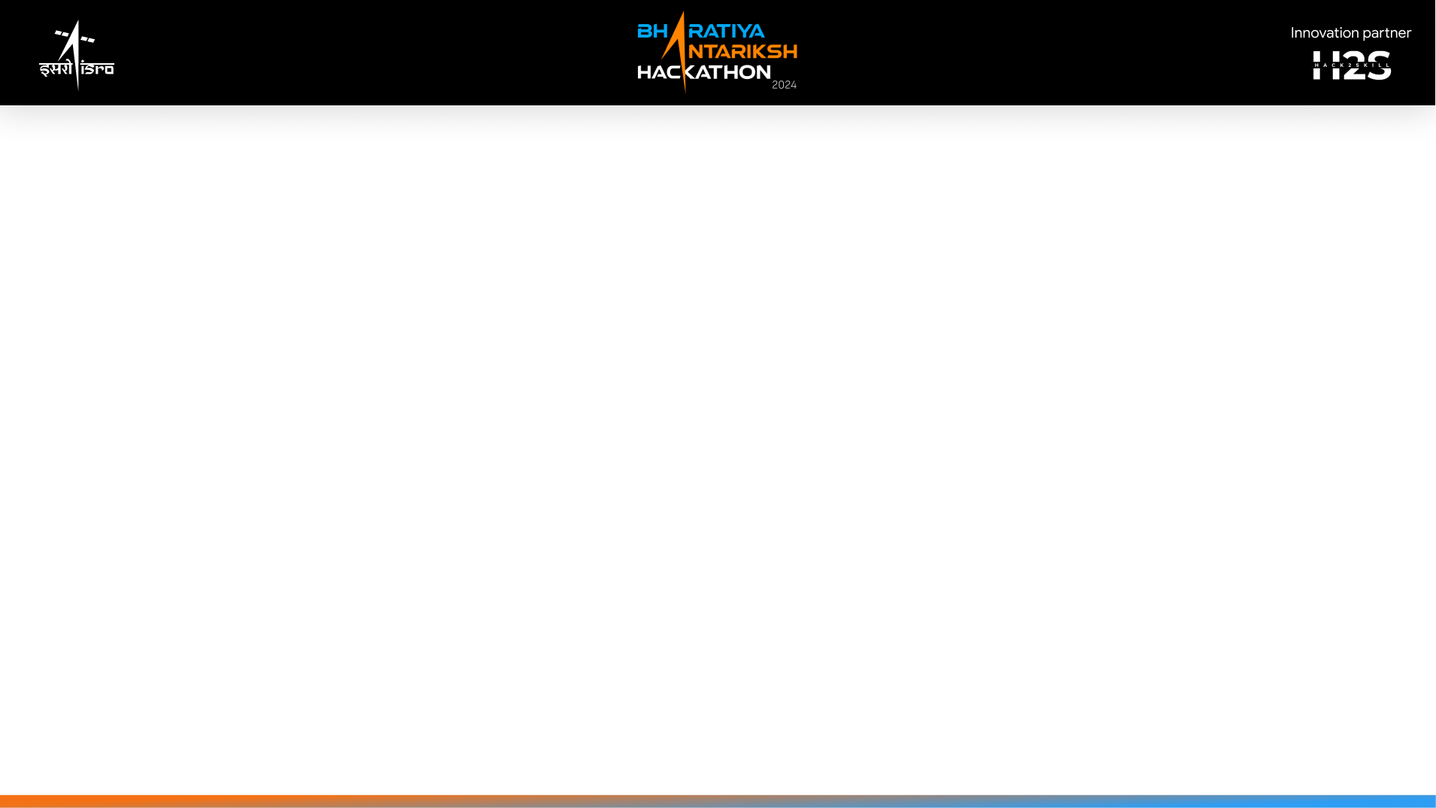
To tackle the challenge of identifying a safe navigation route on the Moon's south pole using Chandrayaan images, we adopted a systematic approach that began with the analysis of the landing site and concluded with the development of a navigable path incorporating scientific stops.
Landing Site Selection and Initial Analysis: We began by focusing on the landing coordinates at 85.28° S, 31.20° E. Using the Chandrayaan-2 Terrain Mapping Camera (TMC) and Digital Terrain Model (DTM), we meticulously analyzed the topography and terrain surrounding this location. This preliminary analysis enabled us to identify potential hazards such as boulders, craters, and steep slopes using Hazard analysis using OpenCV.
Path Development and Scientific Stops: We generated a traverse path extending at least 100 meters from the landing site. Our goal was to ensure the path was free from obstacles and incorporated scientifically valuable stops. The Optical High Resolution Camera (OHRC) data was crucial for identifying detailed surface features, while the Imaging Infra-red Spectrometer (IIRS) provided insights into material composition. We used QGIS to overlay the datasets and delineate a path that avoided large shadows and extreme slopes. The path was designed to be partially in sunlit regions to maximize solar power efficiency for the rover. We identified and marked ten scientifically interesting stops along the route. This process was done with hyperspectral analysis of CH2 IIRS data. These stops included potential sites for mineralogical analysis and observations of unique geological formations.
Path Justification and Detailed Explanation: The chosen path was selected based on the presence of scientifically intriguing features, such as unusual mineral deposits and geological formations, while avoiding hazardous regions. We ensured that the rover's ground clearance was sufficient to navigate the path without encountering obstacles. The path’s alignment was adjusted to optimize solar exposure, preventing the rover from traversing long periods in permanent shadow.
Annotated Map Preparation: An annotated map was created using QGIS, clearly marking the 100-meter traverse path, landing site, and ten stops. The map highlighted major features and ensured that the path adhered to safety and scientific requirements.

Slide 3
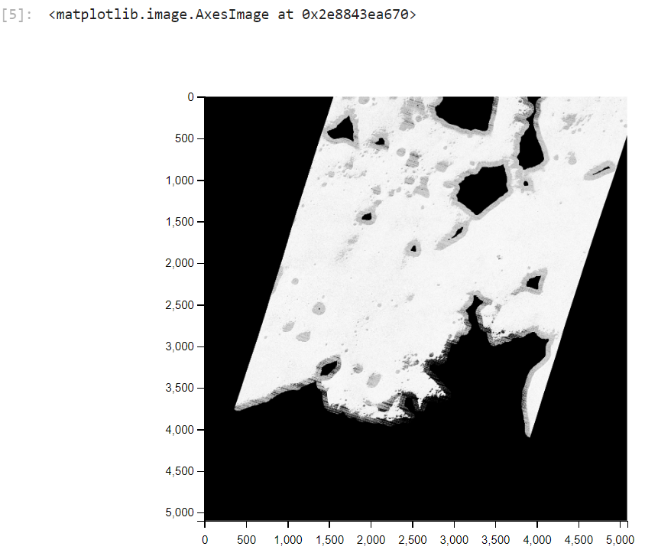
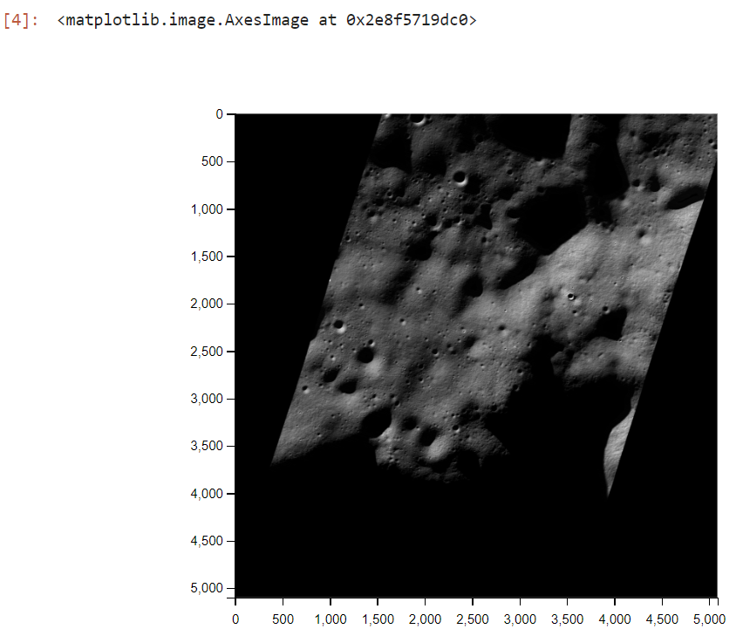
HAZARD MAPPING - COMPUTER VISION BASED APPROACH USING PYTHON AND QGIS AND OPENCV
1. Load raster and Extract Region o? Interest (ROI)
a)Python-opencv and rasterio was used to read tmc data exported as .tif file from qgis after cropping ROI in qgis using raster-extract tool.
b)A slope map or same ROI was extracted from qgis in .tif format by using the raster terrain analysis tool “Slope”. This was read in using rasterio. (z-factor was set to 20.00 to extract only high slope areas)
c)The read data was reshaped to (x, y, bands) shape and stored as numpy arrays

Slide 4
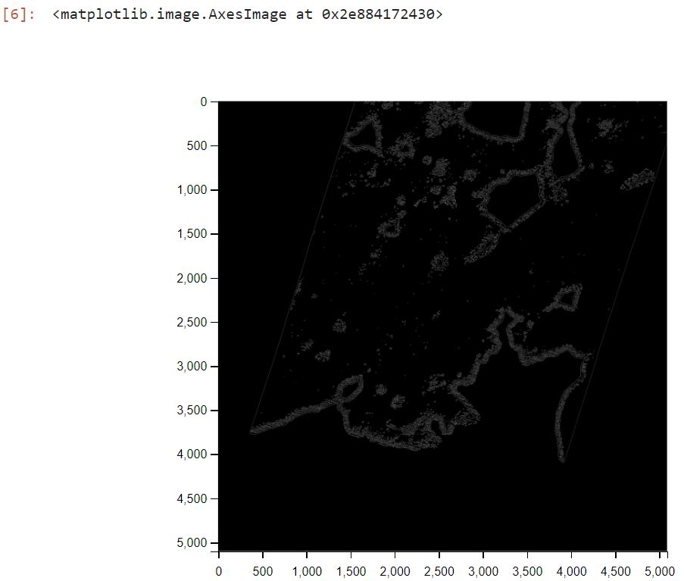
2.Identify High Slope areas
a)Slope map was converted to gray scale and high slope gradient was figured out by identifying values in the np array in the high slope gradient range using cv2.inRange() function.
b)A mask was created using the above function and placed on the tmc roi data to identify high slope regions.

Slide 5
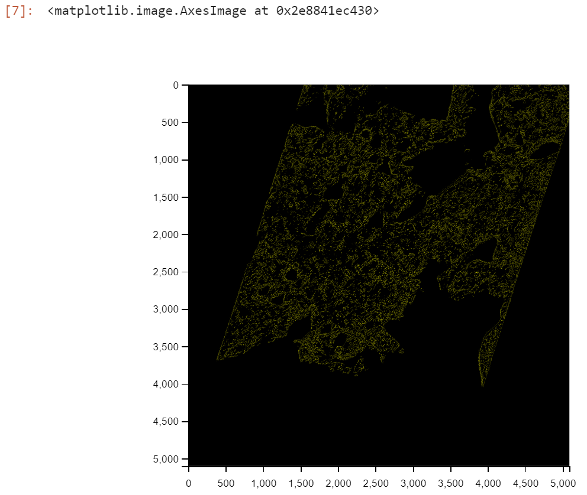
3.Ridge Detection with Canny Edge
a)A copy of the initial roi was extensively blurred using the gaussian blur method for identification of high risk ridges.
b)Opencv Canny Edge algorithm was executed on the blurred image to create a mask of edges found of high risk grayscale gradient. The higher the gradient, the faster neighboring pixels change grayscale values. This mask was superimposed on the tmc roi np array to identify ridges too risky for a rover to cross.
c)The steepness of the ridge was identified by the grayscale intensity of the canny edge mask lines

Slide 6
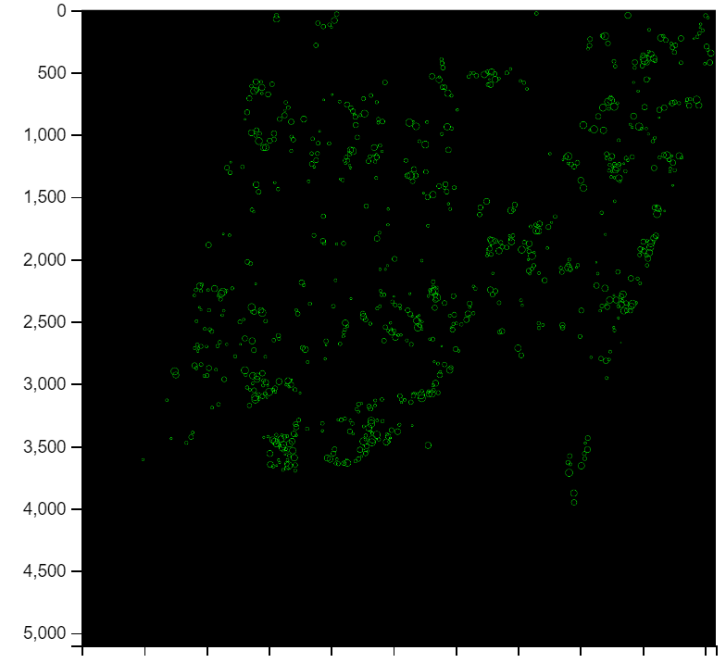
4.Crater Filtering with Hough-Circles Algorithm
a)Original tmc roi was converted to grayscale and blurred.
b)Hough Circles algorithm was fine tuned to identify different craters fitting two category sizes.
c)Both these categories had their own hough circle filter to identify individual craters and dense small-sized crater areas to avoid.

Slide 7
Technologies Used
We utilized Python and Jupyter for data processing and analysis, employing OpenCV for feature detection using Hough Circles and image ROI algorithms. QGIS and ArcMap facilitated map creation and path planning. NumPy supported numerical operations, while the A*/dijkstra algorithm optimized the rover's traverse route, ensuring safety and efficiency.

Slide 8
Differentiation from Existing Ideas:
Our approach stands out by integrating multiple datasets (TMC, DTM, OHRC, and IIRS) to create a comprehensive, multi-layered analysis of the lunar south pole. While traditional methods often rely on single-source data or simplistic path planning, our solution combines advanced image processing (using OpenCV’s Hough Circles and image ROI algorithms) with sophisticated pathfinding techniques (like A*), allowing for a more detailed and scientifically enriched navigation route.
Problem Solving:
The solution addresses the challenge of navigating the Moon's south pole by providing a safe, obstacle-free path that incorporates scientifically valuable stops. By leveraging high-resolution imagery and terrain models, we ensure that the rover avoids hazardous areas such as craters and boulders while maximizing scientific exploration opportunities. The integration of solar considerations and the avoidance of permanent shadows optimize the rover's power efficiency and operational capability. The stop points are determined using the concentrated ice-caps from terrain analysis and the hyperspectral analysis of IIRS.
Unique Selling Proposition (USP):
The USP of our solution lies in its holistic approach combining diverse data sources with advanced algorithms for detailed path planning. This method not only ensures safety by avoiding obstacles but also enhances scientific value by strategically positioning stops for in-depth analysis. The use of Python, Jupyter, OpenCV, Spectral Python and QGIS for integrated data processing and pathfinding ensures a robust, innovative solution that balances practical navigation needs with scientific exploration goals. The use of Hyperspectral Analysis of CH2 IIRS Data.

Slide 9
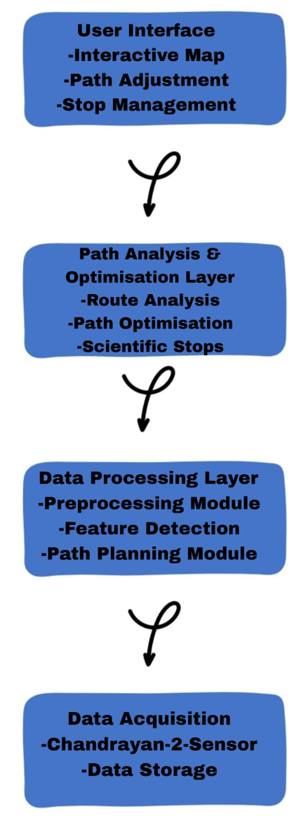
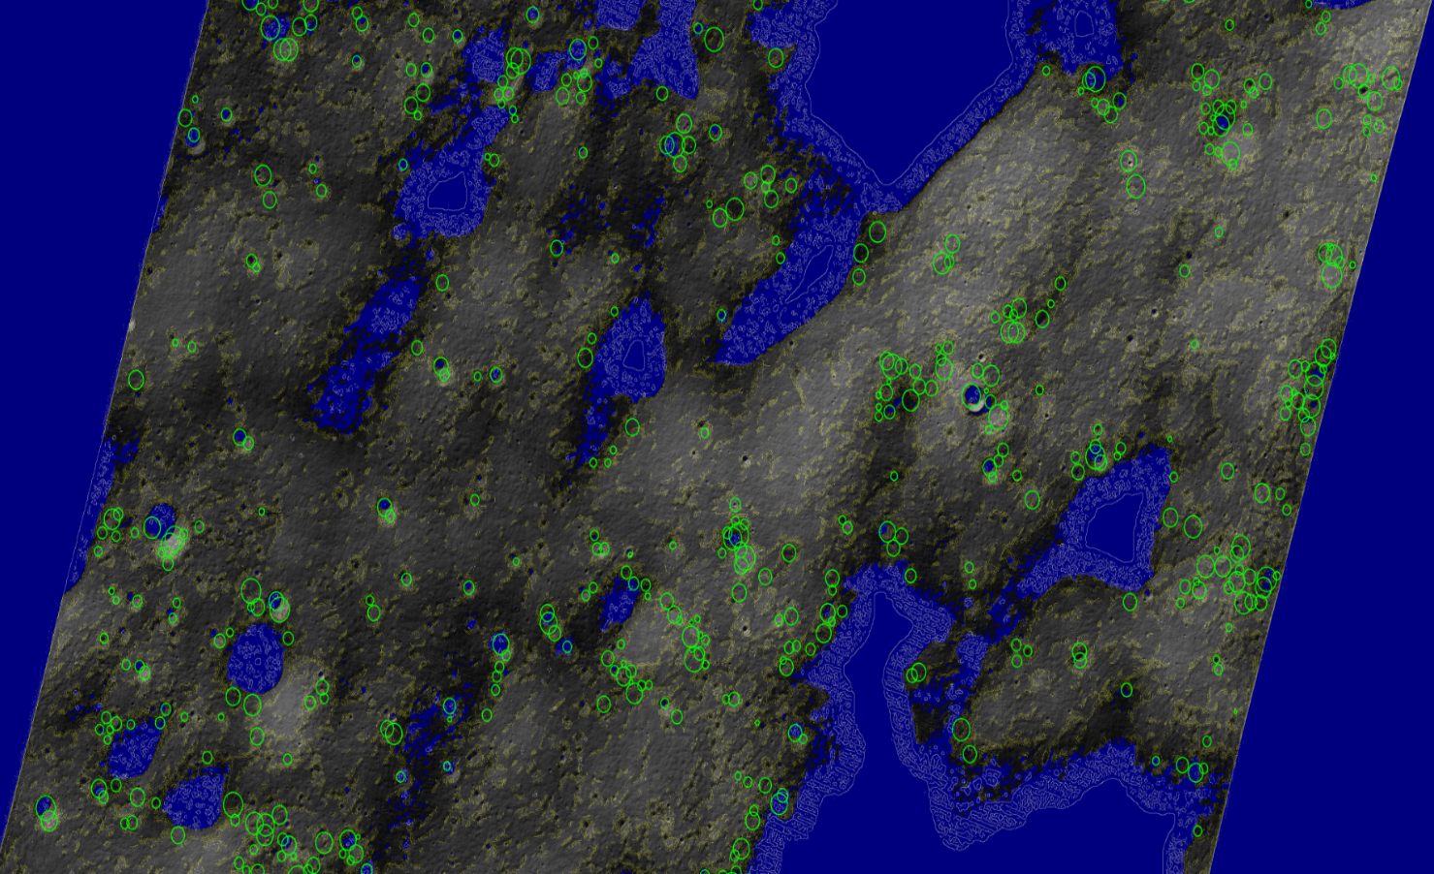

Slide 10
Features Offered by the Solution
High-Resolution Terrain Analysis:
Utilizes data from Chandrayaan-2’s Terrain Mapping Camera (TMC) and Optical High Resolution Camera (OHRC) for detailed terrain analysis.
Provides a clear view of the lunar surface, identifying potential hazards like craters and boulders.
Advanced Feature Detection:
Implements OpenCV’s Hough Circles algorithm to detect and map circular features such as craters.
Uses image ROI algorithms to focus on specific areas of interest.
Optimized Path Planning:
Applies the A* algorithm to generate a safe, obstacle-free path for the rover.
Considers ground clearance and terrain challenges to ensure smooth navigation.
Scientific Stops Identification:
Integrates data from the Imaging Infra-red Spectrometer (IIRS) to pinpoint scientifically significant sites.
Marks at least ten stops for detailed analysis and observations.
Solar Exposure Analysis:
Evaluates the solar exposure of the rover’s path to optimize energy usage and prevent operation in permanently shadowed regions.
Interactive Visualization:
Provides an interactive map using QGIS and ArcMap for users to view and modify the rover’s path and scientific stops.
Offers clear annotations of the traverse route and key features.
Dynamic Path Adjustment:
Allows users to adjust the path and stops based on real-time data and requirements.
Ensures flexibility and adaptability in mission planning.
Annotated Map Creation:
Generates detailed annotated maps showing the rover’s route, scientific stops, and major features.
Enhances mission planning and communication through clear visual representation.

Slide 11
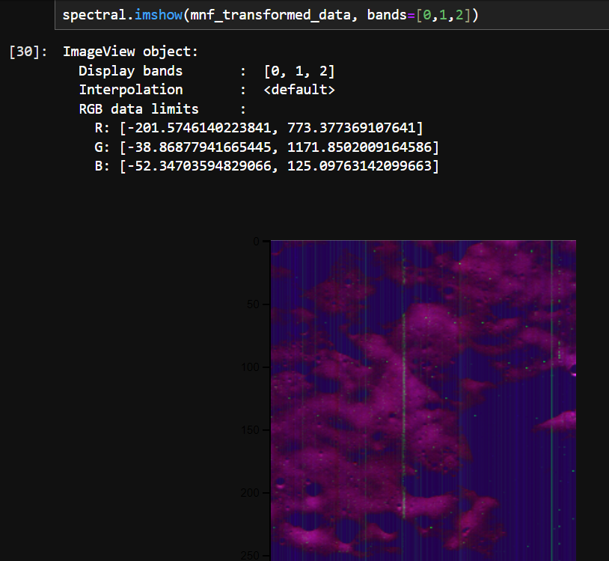

Hyperspectral Analysis of CH2 IIRS Data
1. MNF (Maximum Noise Fraction) method applied to reduce dimensionality of original image.
a.Calculated Noise Covariant Matrix (say cov1)
b.Calculated inverse of cov1
c.Performed Noise whitening
d.Applied PCA to whitened data
e.Sorted eigenvectors in descending order
f.Transformed whitened data using sorted eigenvectors

Slide 12
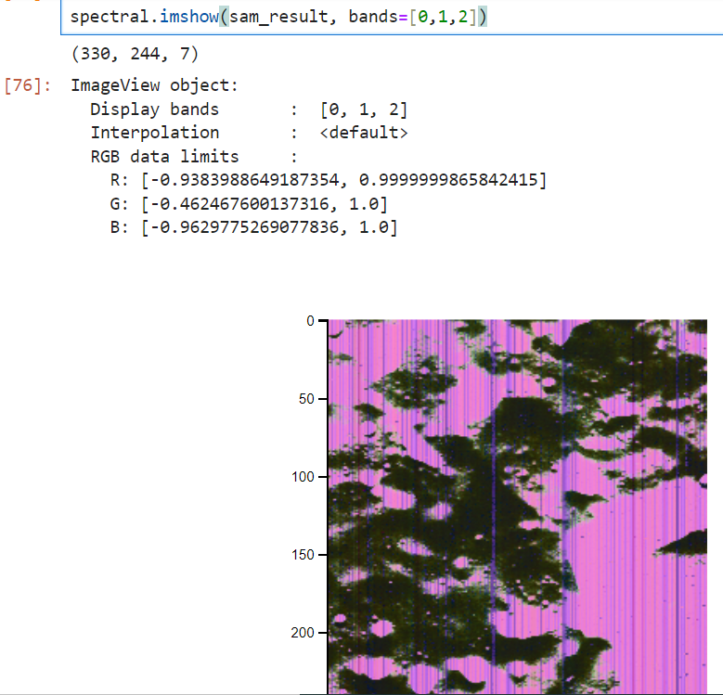
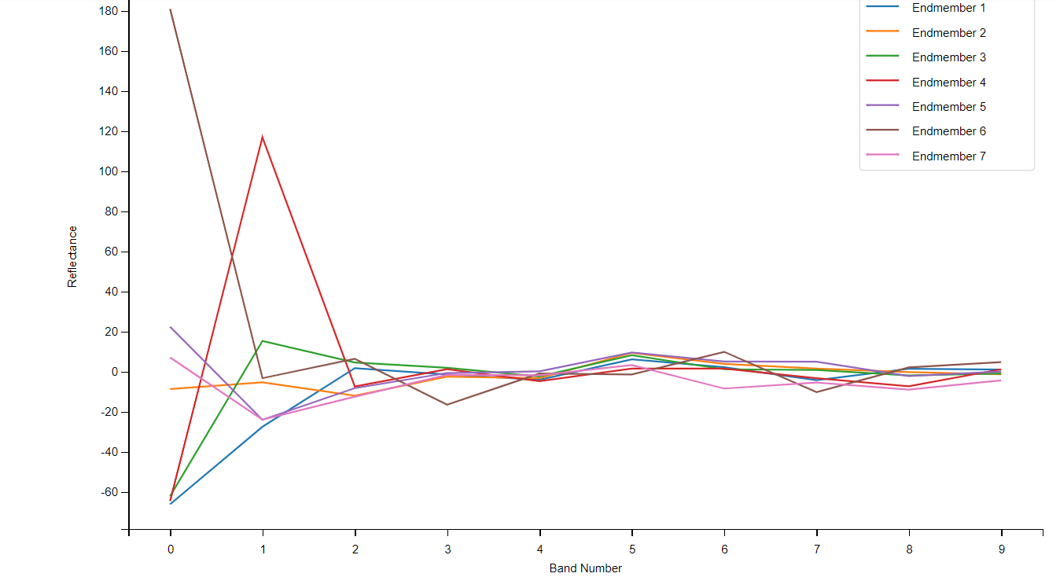

Slide 13
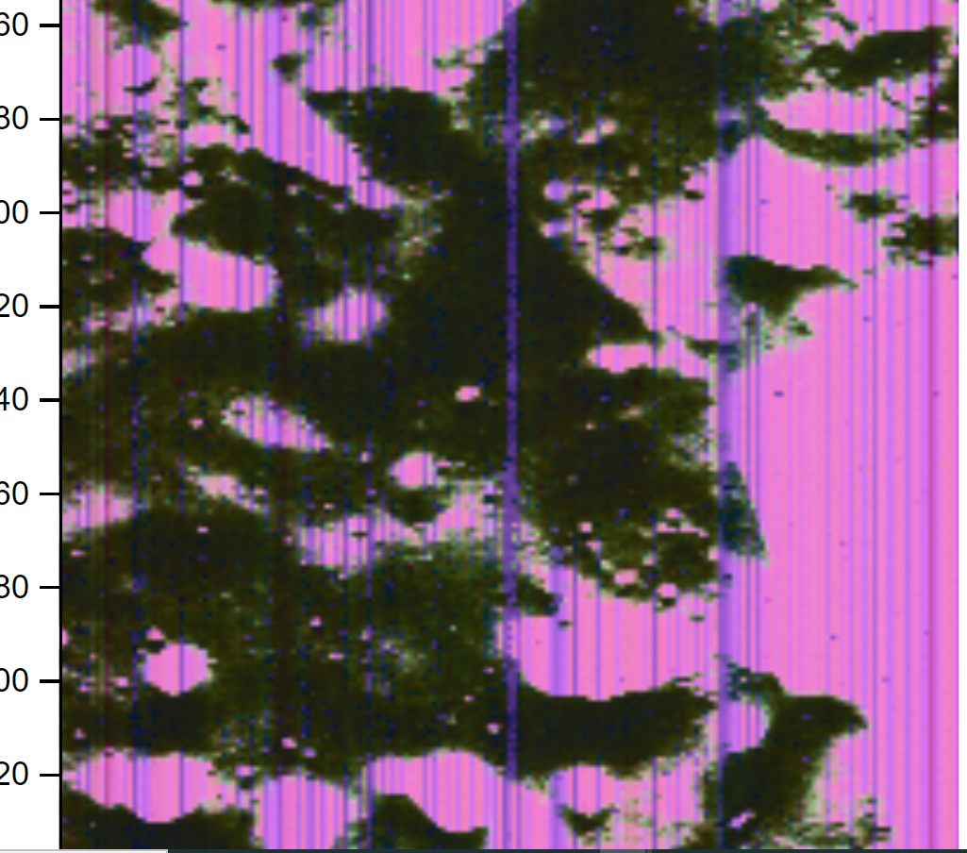
Non Black and Pink regions highlighted by green clusters are the most diverse and concentrated groups of minerals like olivine, anorthosite, pyroxene etc.

Slide 14
Solution Brief: Lunar Rover Navigation System
Objective: The goal of this project was to develop a robust and efficient navigation route for a lunar rover on the south pole region of the Moon using data from Chandrayaan-2 missions. The solution aimed to ensure safe and scientifically valuable exploration by integrating high-resolution imaging and terrain data, advanced feature detection, and optimized path planning.
Key Components:
Data Acquisition:
Utilized imagery and terrain models from Chandrayaan-2’s Terrain Mapping Camera (TMC), Optical High Resolution Camera (OHRC), and Imaging Infra-red Spectrometer (IIRS) to gather comprehensive surface and topographic data.
Data Processing:
Employed preprocessing techniques to enhance and prepare data for analysis.
Applied OpenCV algorithms, including Hough Circles and image ROI, to detect and map surface features such as craters and boulders.
Path Planning:
Used the A* algorithm to generate an obstacle-free path for the rover, ensuring it avoids hazardous areas while maintaining a minimum distance of 100 meters from the landing site.
Analyzed solar exposure to optimize energy efficiency and avoid long periods in permanently shadowed regions.
Path Analysis and Optimization:
Incorporated scientific data to identify and mark at least ten significant stops along the path for in-depth analysis and exploration.
Created an annotated map highlighting the rover’s route and key features, facilitating mission planning and execution.
Interactive Visualization:
Developed interactive maps using QGIS and ArcMap to visualize the rover’s path and scientific stops.
Enabled users to adjust and optimize the route based on real-time data and mission requirements.

Slide 15
Unique Selling Proposition (USP): The solution integrates a multi-layered approach combining diverse datasets and advanced algorithms, providing a detailed, obstacle-free path for the rover that maximizes scientific value and operational efficiency. The use of interactive visualization tools ensures that mission planning is both flexible and user-friendly.
Benefits:
Safety: Ensures the rover navigates through safe terrain, avoiding obstacles and hazards.
Scientific Value: Strategically positions the rover to explore scientifically significant sites.
Efficiency: Optimizes solar exposure to enhance the rover’s energy utilization.
Flexibility: Offers an interactive platform for dynamic route adjustments and stop management.
This solution provides a comprehensive framework for lunar rover navigation, balancing practical navigation needs with scientific exploration goals.

Slide 16


